Slide 1


Evolution of Metal Usage in Ancient Protein Domains
Nandini Manepalli, Sawsan Wehbi, Joanna Masel
Arizona NASA Space Grant Student Research Symposium
April 18, 2026

Slide 2
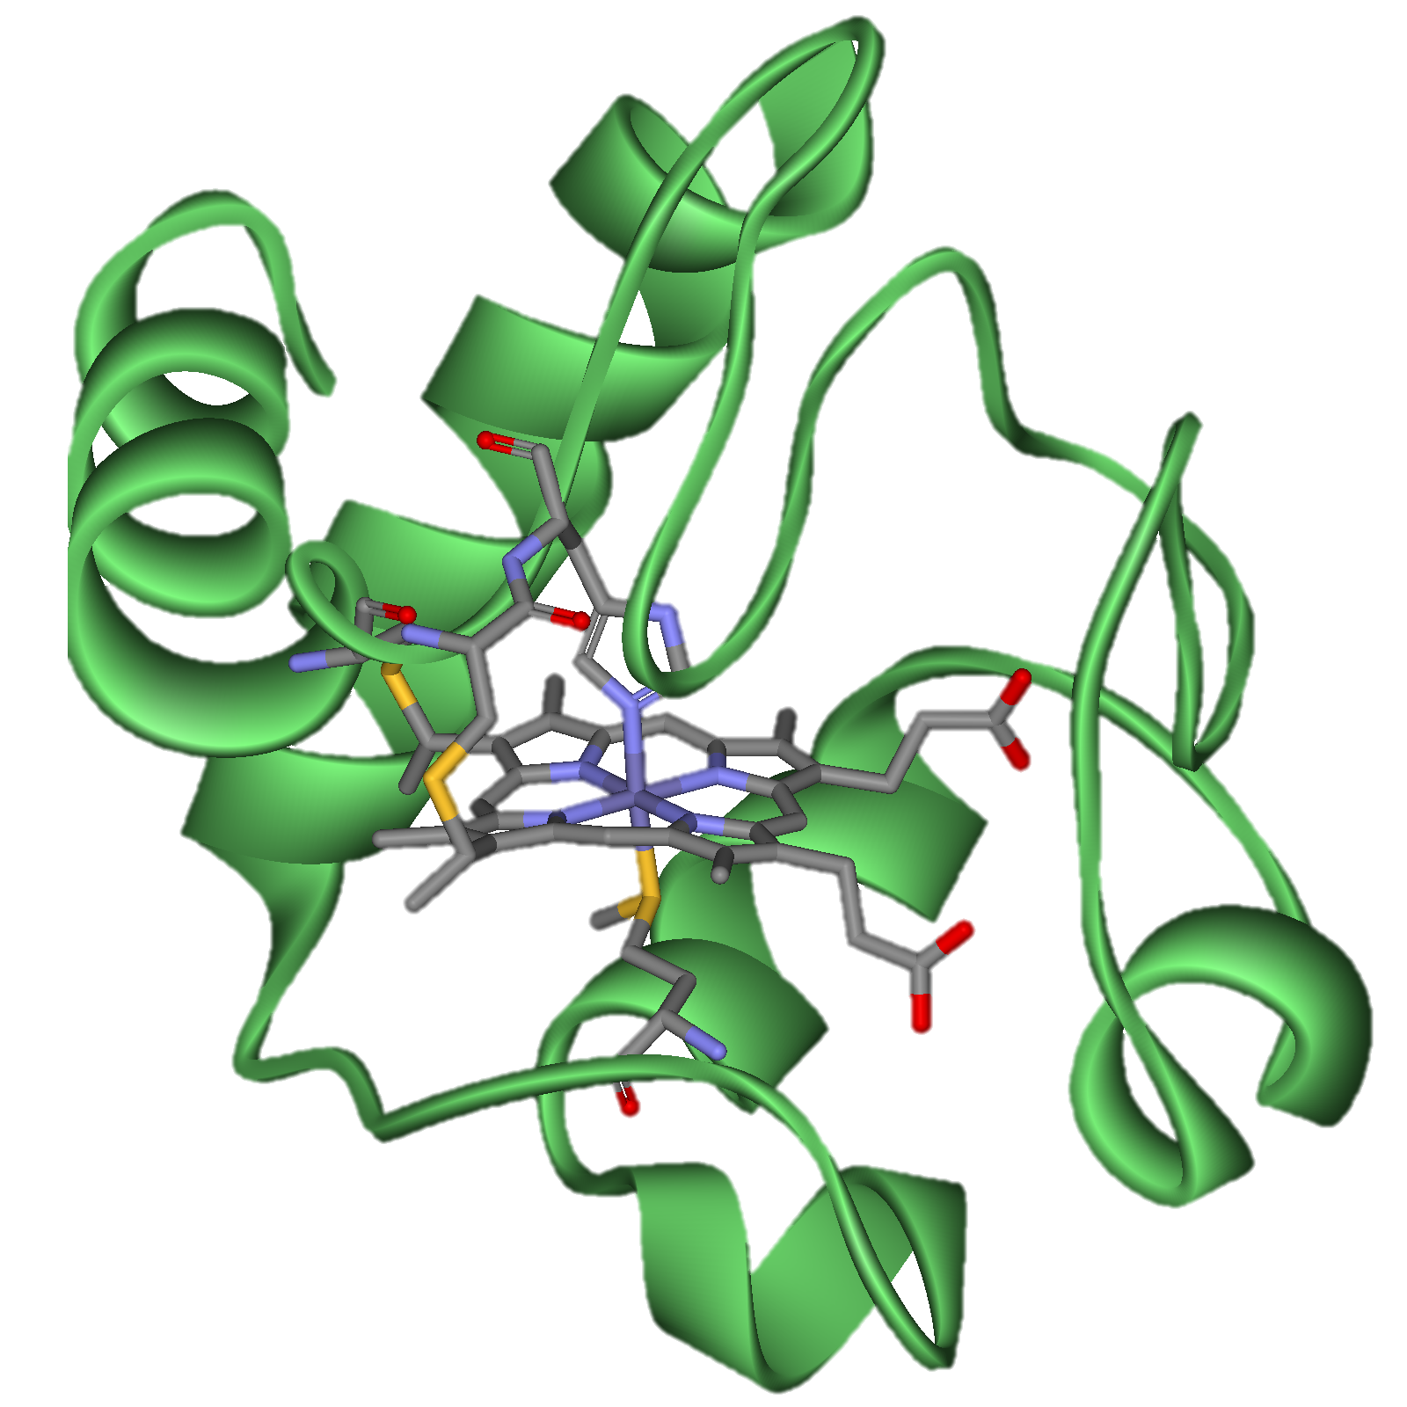
Metalloproteins
Many proteins bind transition metals (Fe, Mn, Co, Ni, Cu, Zn)
  Useful in facilitating biological reactions by transferring electrons
Many metalloproteins are ancient, dating back to the Last Universal Common Ancestor (LUCA)
  LUCA: Community of organisms from which all life on Earth is believed to have been descended from
Heme group bound to cytochrome protein, important for making ATP

Slide 3
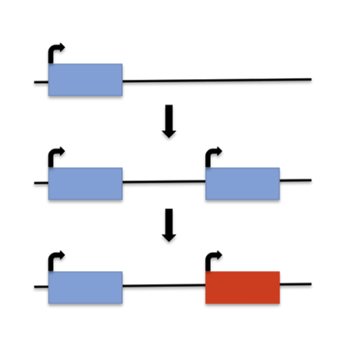
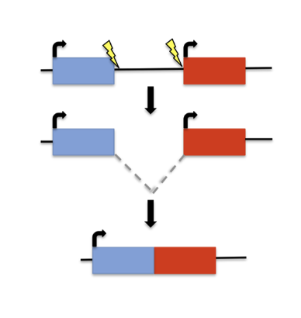
Genes are born at different times
Not all genes emerged at the dawn of life
Some genes emerged de novo (from noncoding regions)
Some genes evolve from pre-existing genes
Gene 1
Gene 2
Gene 1
Gene 1
Gene 1 copy
Gene 1
New gene
New gene
Gene Duplication
Gene Fusion

Slide 4
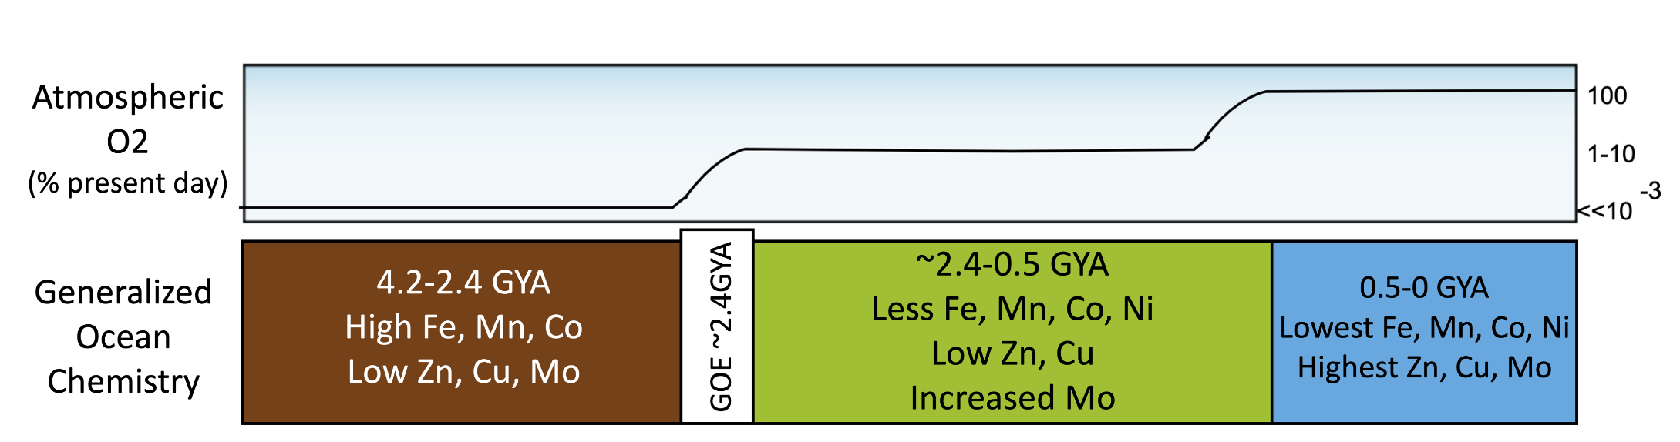
Earth has shaped the evolution of life, and vice versa!
~2.4 billion years ago, early cyanobacteria began performing photosynthesis to generate energy, releasing O₂ into the atmosphere
  Dramatically affected the abundance of different transition metals
~2.4-0.5 GYA
Less Fe, Mn, Co, Ni
Low Zn, Cu
Increased Mo
~0.5-0 GYA
Lowest Fe, Mn, Co, Ni
Highest Zn, Cu, Mo

Slide 5

Which transition metals are used more often by ancient proteins compared to proteins that emerged more recently?
Patterns of transition metal adoption could be driven by bioavailability (supply) or functional importance (demand)
  Biomarkers that track what is demanded by life are likely to be more reliable than those that track more contingent facts about availability

Slide 6


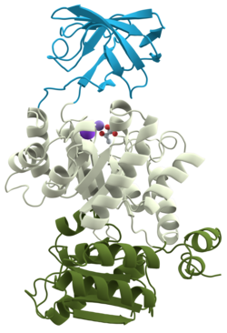
Protein domains
Domains: basic units of proteins that can fold, function, and evolve independently
  Akin to a wheel (domain) that is a part of the larger car (protein)
Domain 1
Many proteins consist of multiple domains
  Each potentially varying in evolutionary age
Domain 2
Domain 3

Slide 7
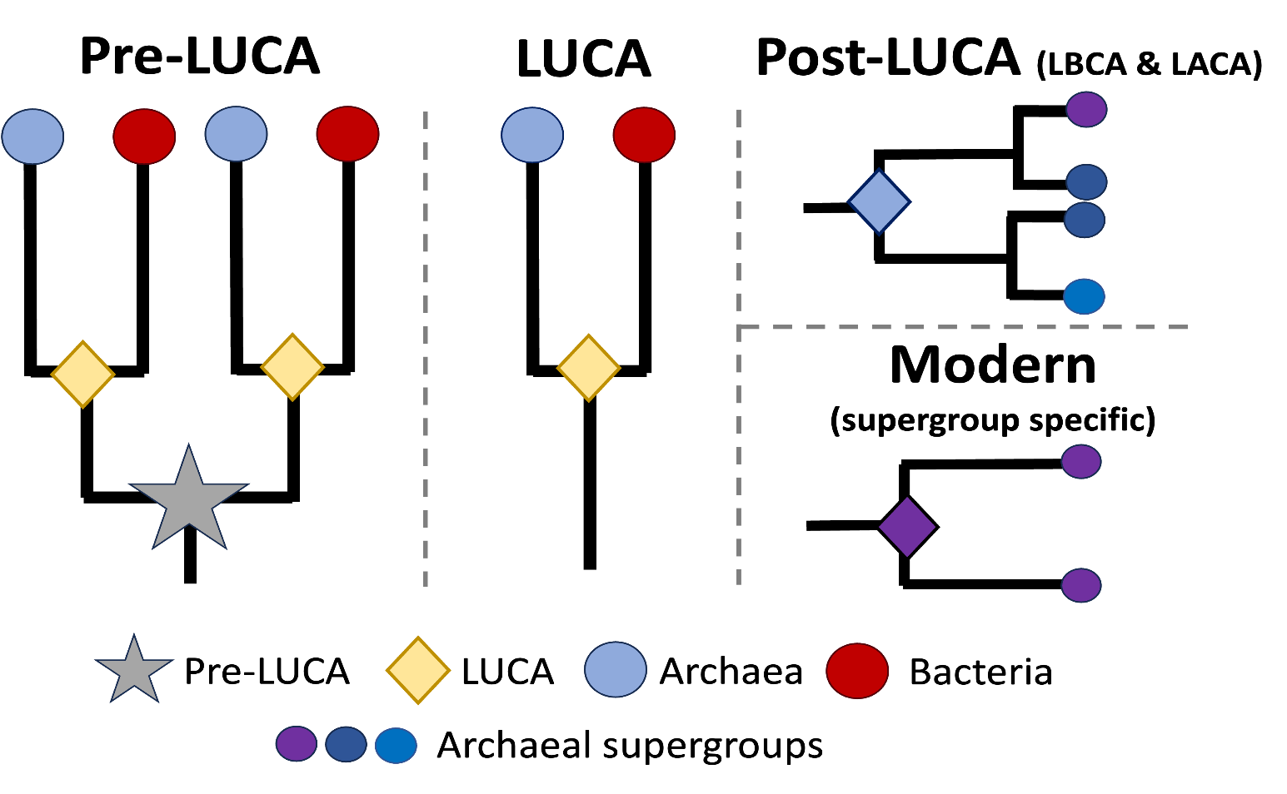
Protein domains
Wehbi et. al (2024) previously classified protein domains based on their age group via phylogenetic reconstruction
Each age group reflects a unique geochemical environment on ancient Earth
Pre-LUCA
LUCA
Post-LUCA (LBCA & LACA)
Modern
(supergroup specific)
Pre-LUCA
LUCA
Archaea
Bacteria
Archaeal supergroups

Slide 8
Protein domains
Wehbi et. al (2024) previously classified protein domains based on their age group via phylogenetic reconstruction
Each age group reflects a unique geochemical environment on ancient Earth
Pre-LUCA
LUCA
Post-LUCA (LBCA & LACA)
Modern
(supergroup specific)
Pre-LUCA
LUCA
Archaea
Bacteria
Archaeal supergroups

Slide 9
Protein domains
Wehbi et. al (2024) previously classified protein domains based on their age group via phylogenetic reconstruction
Each age group reflects a unique geochemical environment on ancient Earth
Pre-LUCA
LUCA
Post-LUCA (LBCA & LACA)
Modern
(supergroup specific)
Pre-LUCA
LUCA
Archaea
Bacteria
Archaeal supergroups

Slide 10
Protein domains
Wehbi et. al (2024) previously classified protein domains based on their age group via phylogenetic reconstruction
Each age group reflects a unique geochemical environment on ancient Earth
Pre-LUCA
LUCA
Post-LUCA (LBCA & LACA)
Modern
(supergroup specific)
Pre-LUCA
LUCA
Archaea
Bacteria
Archaeal supergroups

Slide 11
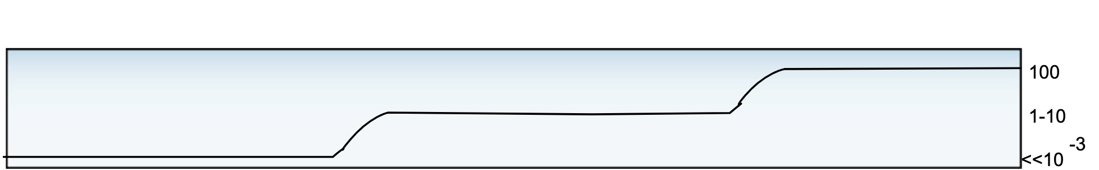
Protein domains
Wehbi et. al (2024) previously classified protein domains based on their age group via phylogenetic reconstruction
Each age group reflects a unique geochemical environment on ancient Earth
Post-LUCA
~3.5 – 2.7 GYA
Pre-LUCA/LUCA
~4.2 – 3.5 GYA
Modern 2.7 GYA – Present day
~2.4-0.5 GYA
Less Fe, Mn, Co, Ni
Low Zn, Cu
Increased Mo
~0.5-0 GYA
Lowest Fe, Mn, Co, Ni
Highest Zn, Cu, Mo
Atmospheric O2
(% present day)
Generalized Ocean
Chemistry
4.2-2.4 GYA
High Fe, Mn, Co
Low Zn, Cu, Mo
0.5-0 GYA
Lowest Fe, Mn, Co, Ni
Highest Zn, Cu, Mo
GOE ~2.4GYA
~2.4-0.5 GYA
Less Fe, Mn, Co, Ni
Low Zn, Cu
Increased Mo
Pre-LUCA
LUCA
Post-LUCA (LBCA & LACA)
Modern
(supergroup specific)
Pre-LUCA
LUCA
Archaea
Bacteria
Archaeal supergroups

Slide 12
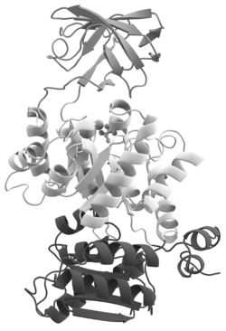
Data collection and analysis
Retrieving experimental protein structures where a protein-metalbinding interaction has been recorded (BioLiP & PDB)
Identifying which protein domain the metal binding site is located in (PDBfam)
  What metal(s) is the domain binding to?
  How many metalbinding sites are within the domain?
Fe ion bound to protein
Fe ion bound to middle protein domain
3) Use inferred evolutionary ages of identified protein domains to understand how protein metalbinding has evolved
Notes:
What I did literally:
Use the BioLiP Database, which records instances of metalbinding in experimentally determined structures
For each protein-metal interaction recorded in BioLiP, used PDBfam to identify which domain the metal-binding site was actually located in
Combined information about the metal-binding properties of different domains with their evolutionary ages

Slide 13
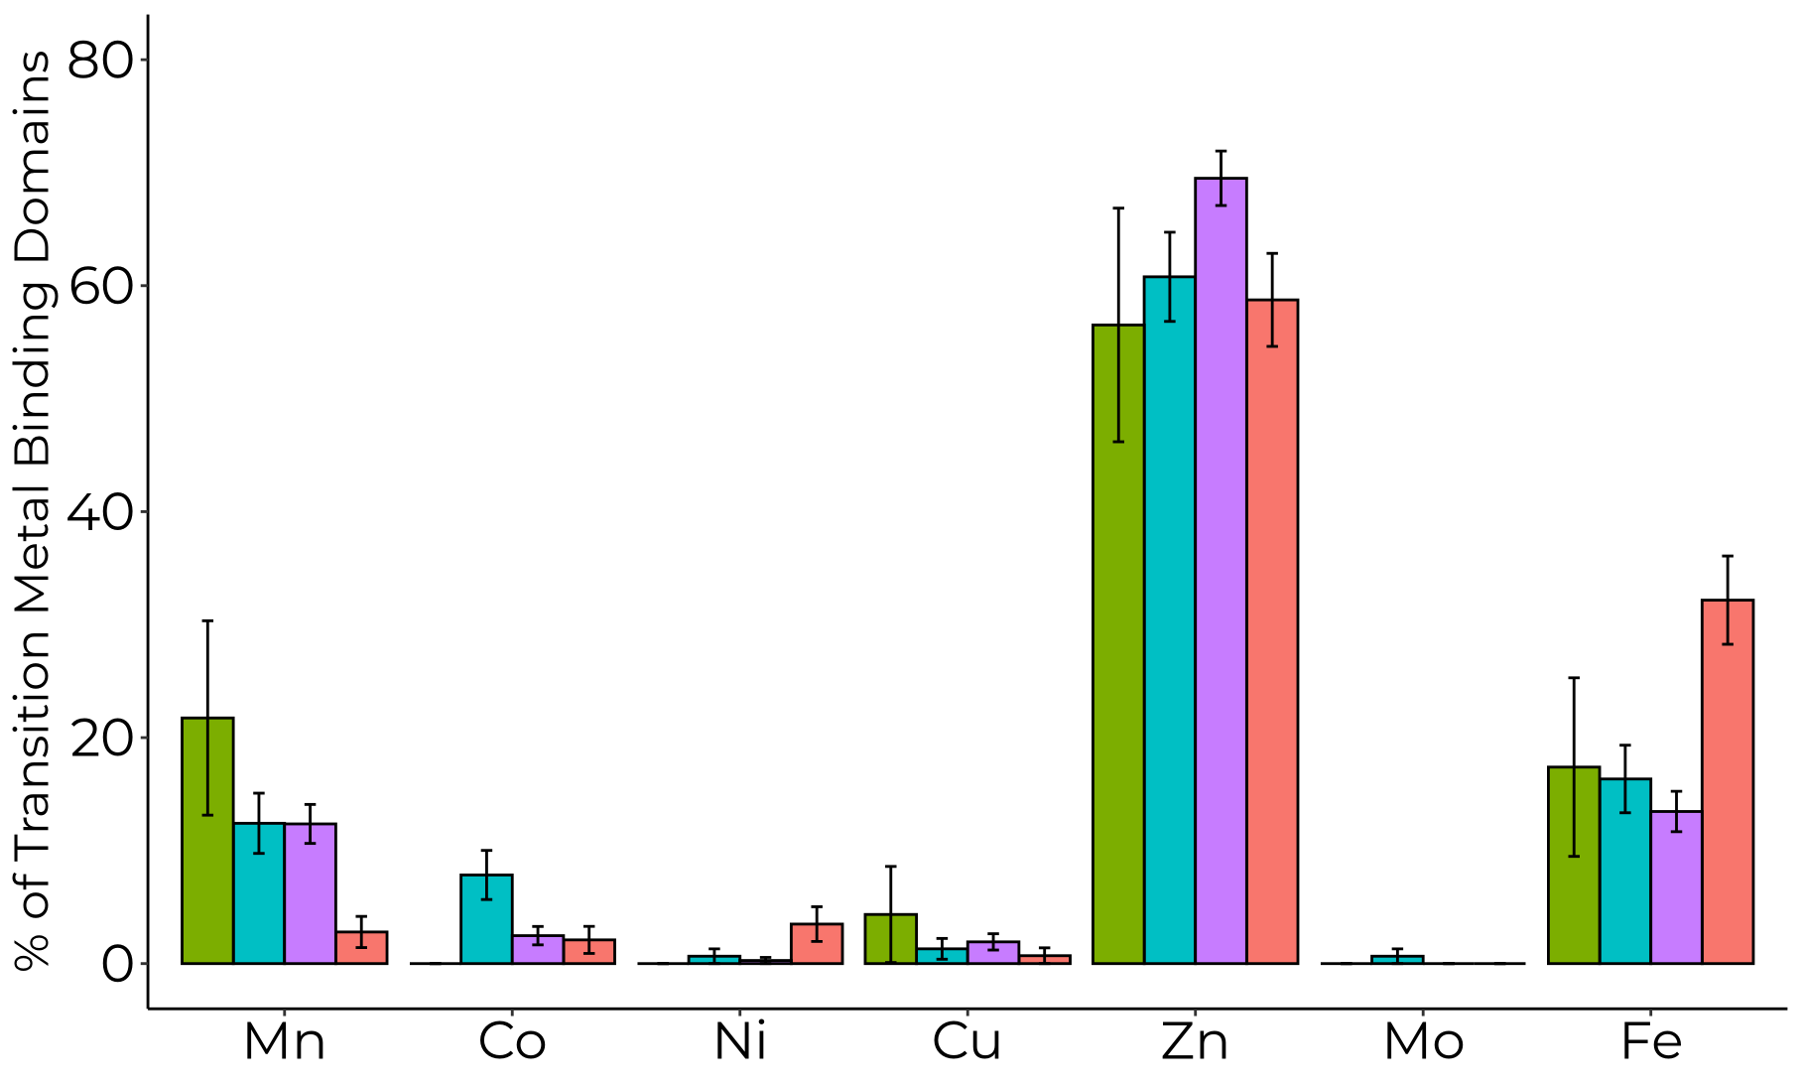
Manganese and cobalt fit the supply hypothesis, but iron doesn’t
**
**
*
Notes:
Here we see that ancient domains bind manganese more often than younger domains. So similar to Iron, in the Archaean ocean Manganese primarily existed in in its soluble form, contributing to high concentrations of Magnesium in the Ocean. After the great oxidation event, manganese was oxidized to a less soluble form that leads to manganese deposits in ancient sedimentary rocks

Slide 14
Manganese and cobalt fit the supply hypothesis, but iron doesn’t
Younger domains are less likely to bind manganese and cobalt, aligning with their scarcity after the GOE
**
**
*
Notes:
Here we see that ancient domains bind manganese more often than younger domains. So similar to Iron, in the Archaean ocean Manganese primarily existed in in its soluble form, contributing to high concentrations of Magnesium in the Ocean. After the great oxidation event, manganese was oxidized to a less soluble form that leads to manganese deposits in ancient sedimentary rocks

Slide 15
Manganese and cobalt fit the supply hypothesis, but iron doesn’t
Younger domains are more likely to bind iron, despite increasing scarcity after the GOE
**
**
*
Notes:
Here we see that ancient domains bind manganese more often than younger domains. So similar to Iron, in the Archaean ocean Manganese primarily existed in in its soluble form, contributing to high concentrations of Magnesium in the Ocean. After the great oxidation event, manganese was oxidized to a less soluble form that leads to manganese deposits in ancient sedimentary rocks

Slide 16
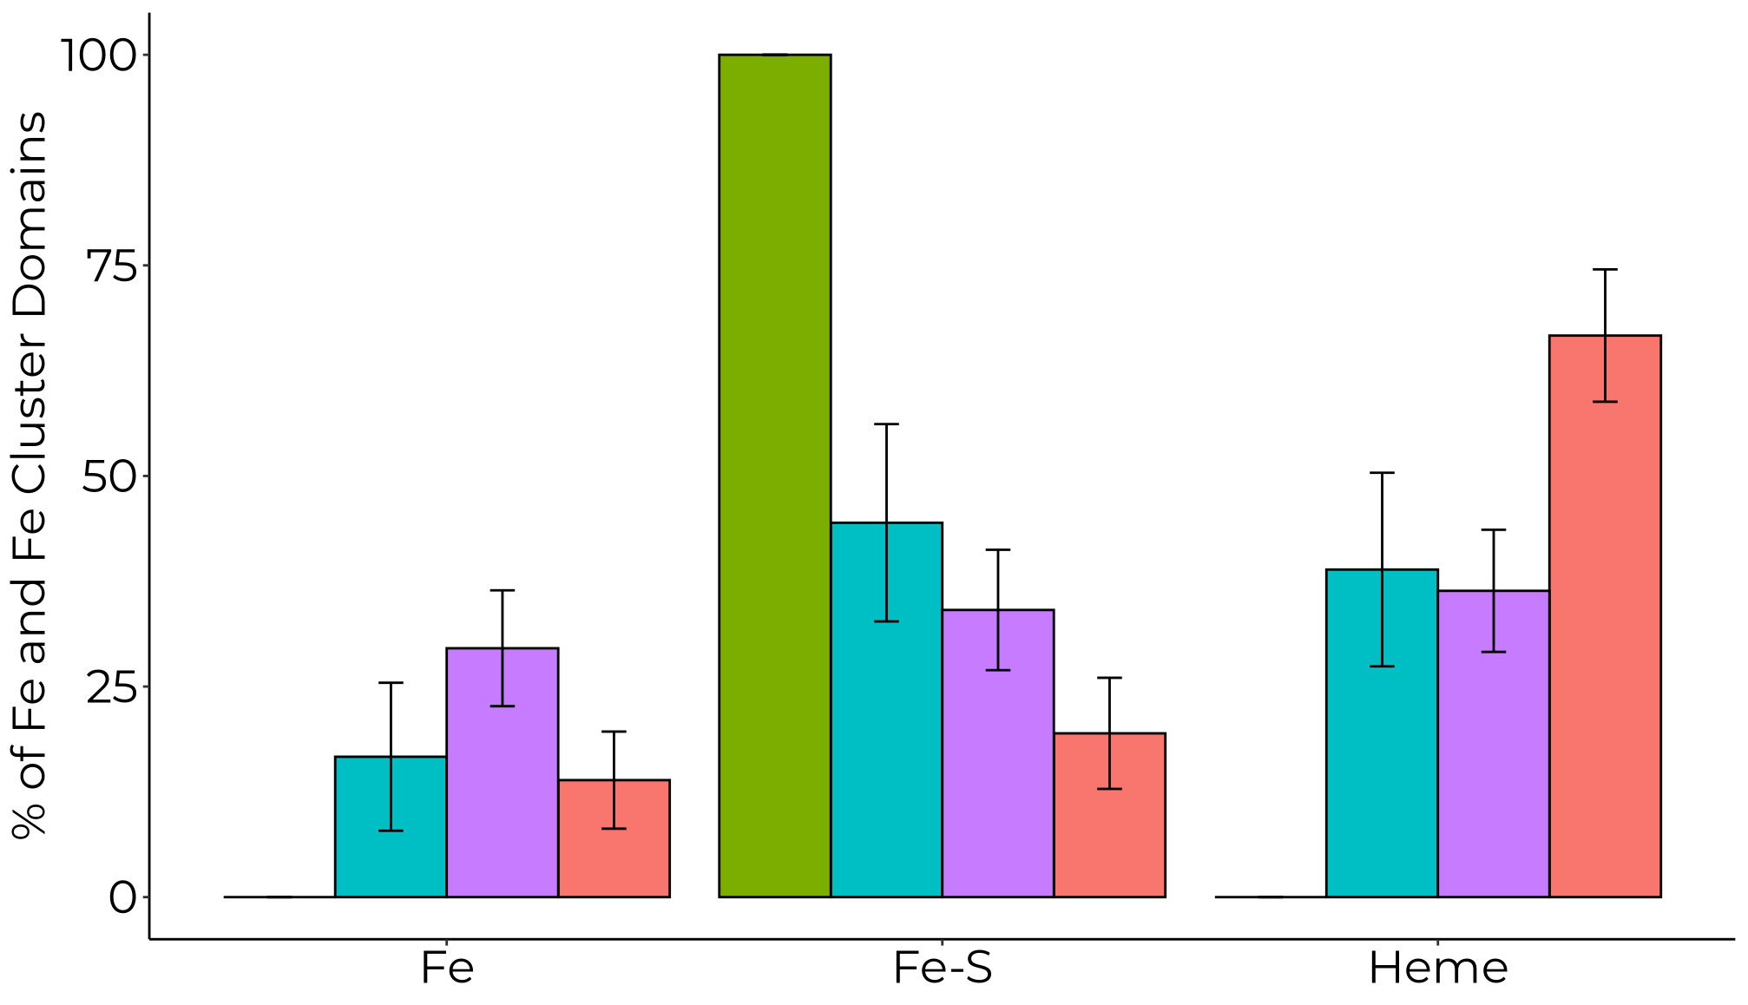
Younger domains more likely to use iron via heme
*
*
Notes:
Here we see that ancient domains bind manganese more often than younger domains. So similar to Iron, in the Archaean ocean Manganese primarily existed in in its soluble form, contributing to high concentrations of Magnesium in the Ocean. After the great oxidation event, manganese was oxidized to a less soluble form that leads to manganese deposits in ancient sedimentary rocks

Slide 17
Conclusions
Metal usage trends:
  Ancient domains are more likely to bind manganese and cobalt, fitting the supply hypothesis
  Younger domains are more likely to bind iron, via heme, despite its scarcity following the great oxygenation event — underscoring the functional importance of iron
Ongoing work focuses on inferring the ancestral state of domains that bind multiple metals

Slide 18





Acknowledgements
Sawsan
Wehbi
Joanna Masel
Andrew Wheeler

Slide 19
Thank you!

